Slide 1

Automated feature and defect analysis for semiconductors materials
DP Project
29 Jan 2025

Slide 2

Zoom in on the chip in your smartphone (ASML)

Slide 3
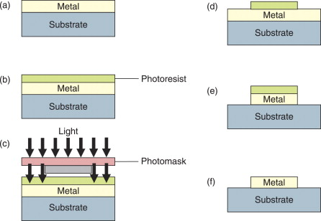
Photolithography | Overview

Slide 4
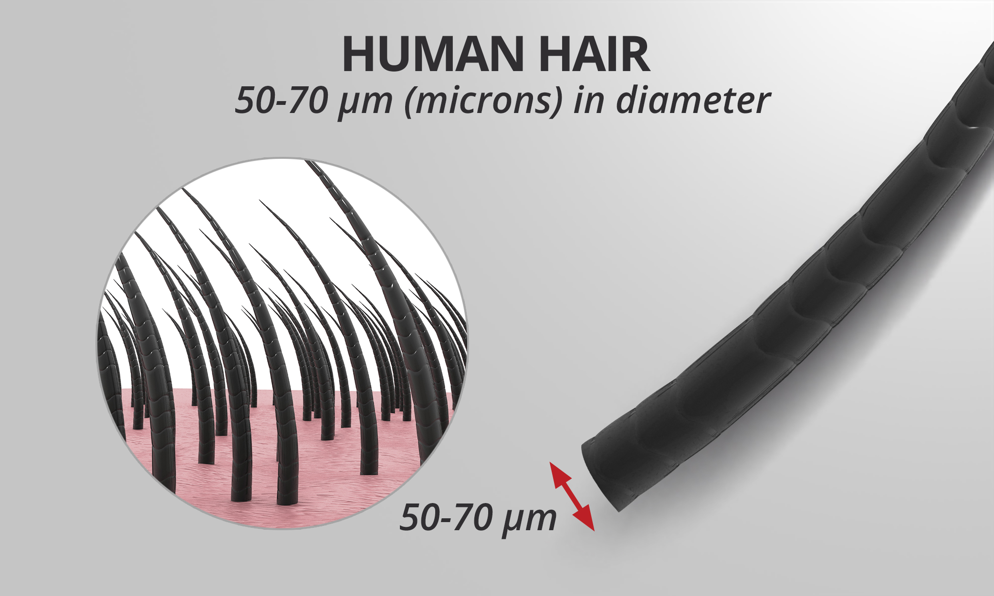
Defects
Defects are random in nature, and they cause yield loss (kill device)
Defects: particles, contamination, scratches, lithography process
Classify them
Defect analysis (scanning electron microscopy)

Slide 5
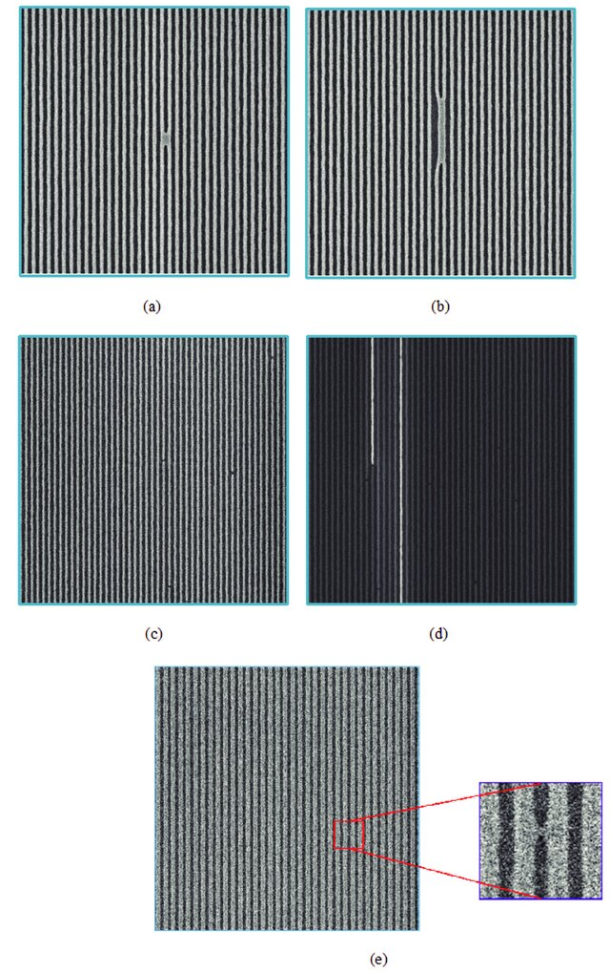
Defects
Bridge defect
Line-collapse
Notes:
https://www.researchgate.net/publication/361262993_Deep_learning-based_defect_classification_and_detection_in_SEM_images/figures?lo=1

Slide 6
Defects
Gap defects

Slide 7
Defects
Bridge defects

Slide 8
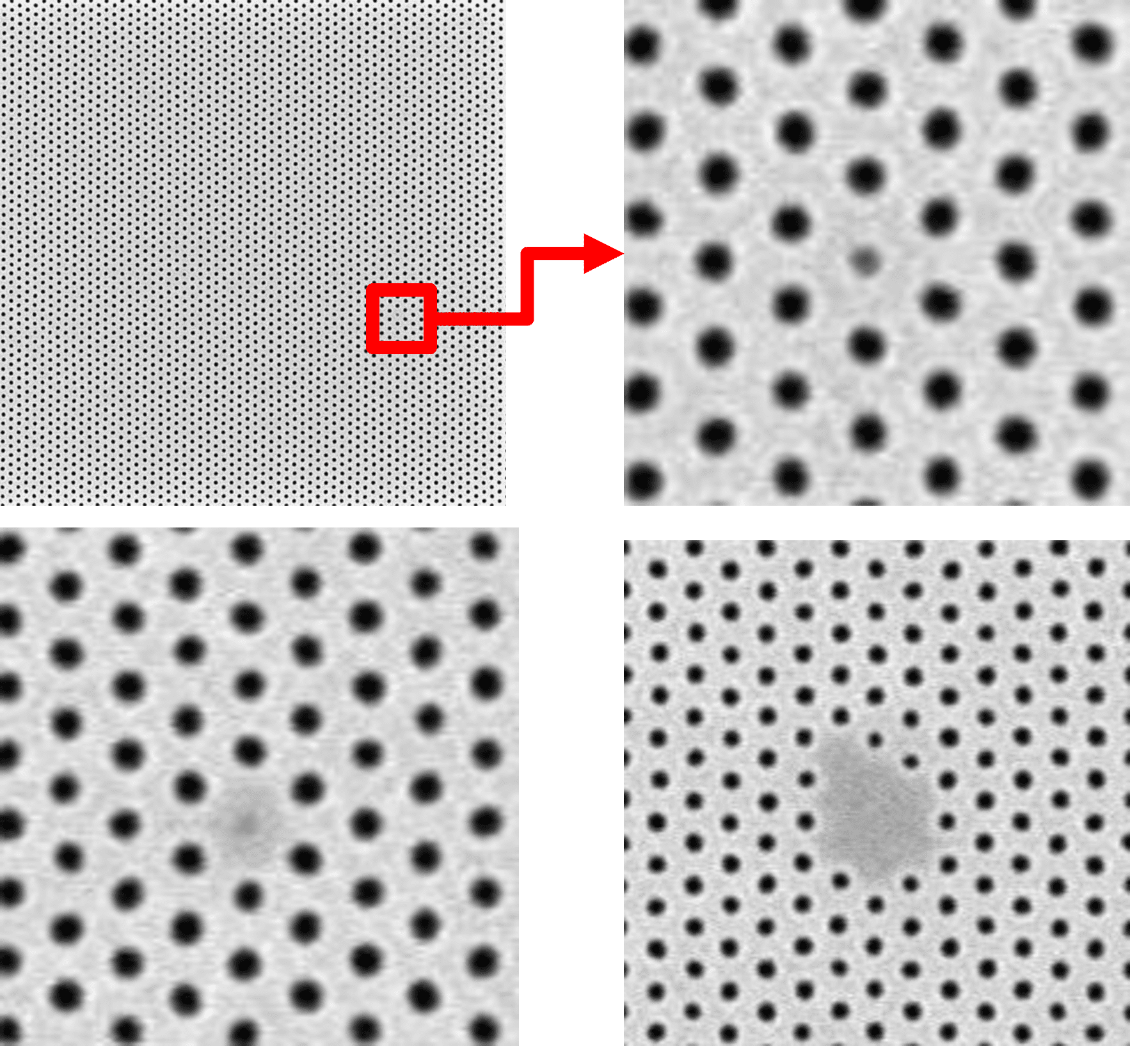
Defects
Contact holes

Slide 9
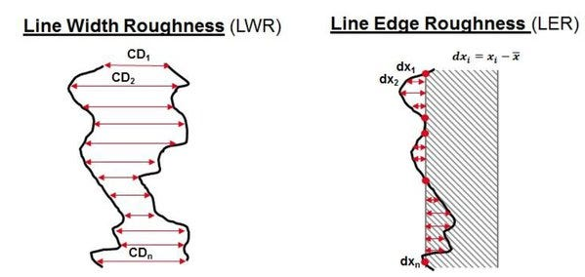
Line-edge & line-width roughness (LER & LWR)
LER: lines of device features are not straight
LWR: distance between lines is not uniform
LER and LWR arise from the lithography and etching process

